Slide 1
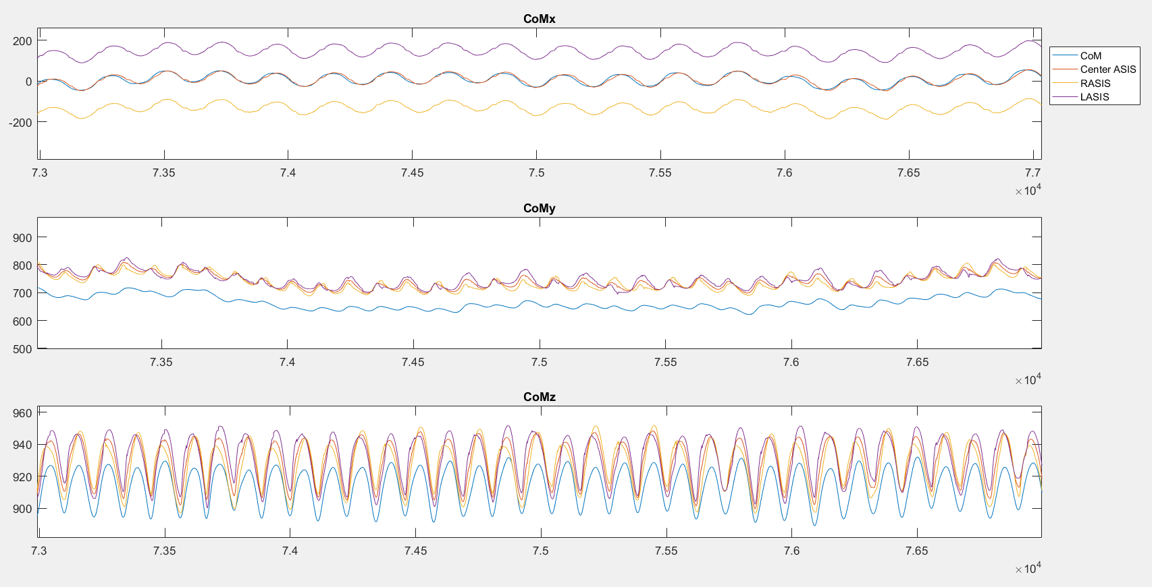
Subject #1: CoM vs ASIS markers

Slide 2
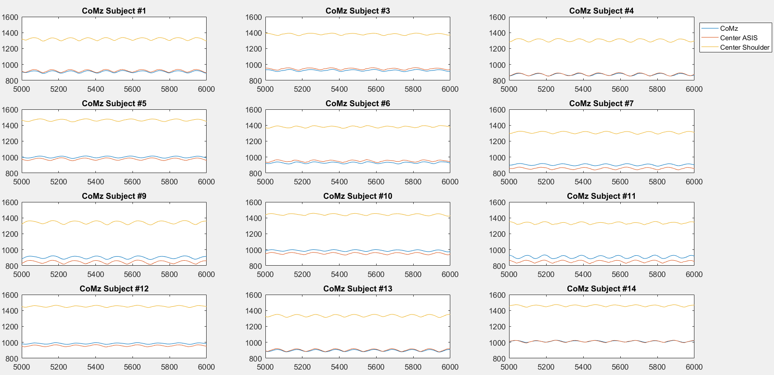
CoMz vs Asis and Shoulder markers

Slide 3
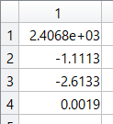
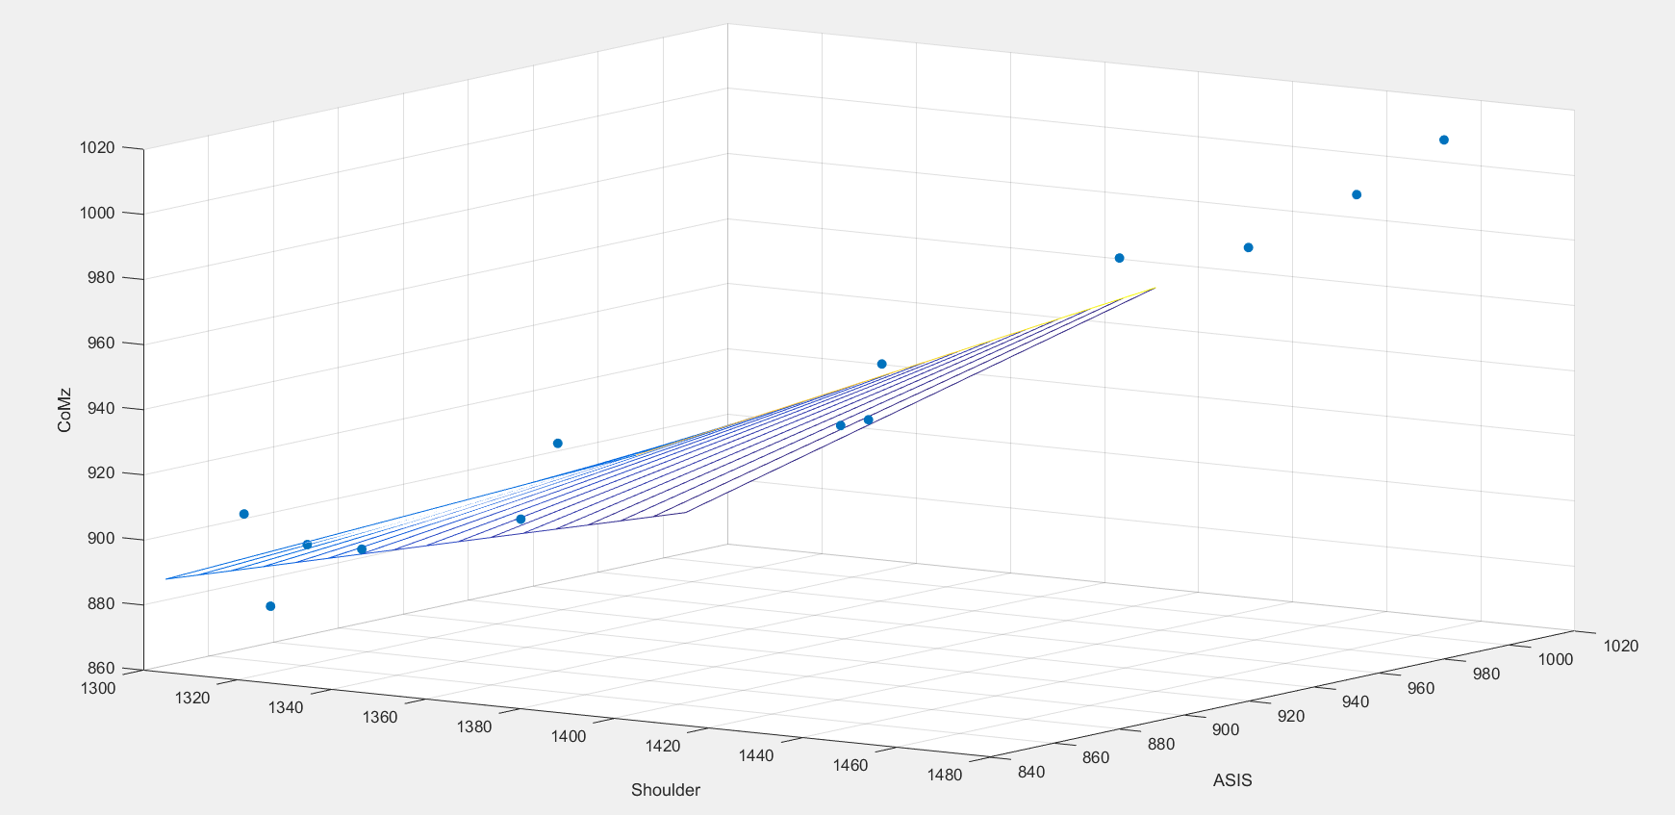
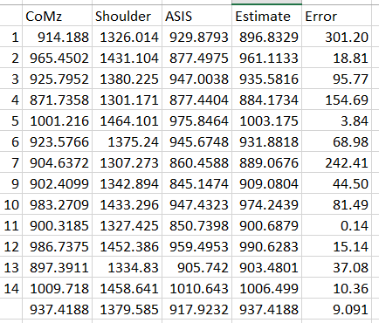
Multiple Regression to find coefficients
CoMz ~ 2406.8 – 1.1113*Shoulder – 2.6133*Asis + 0.0019*Asis*Shoulder

Slide 4
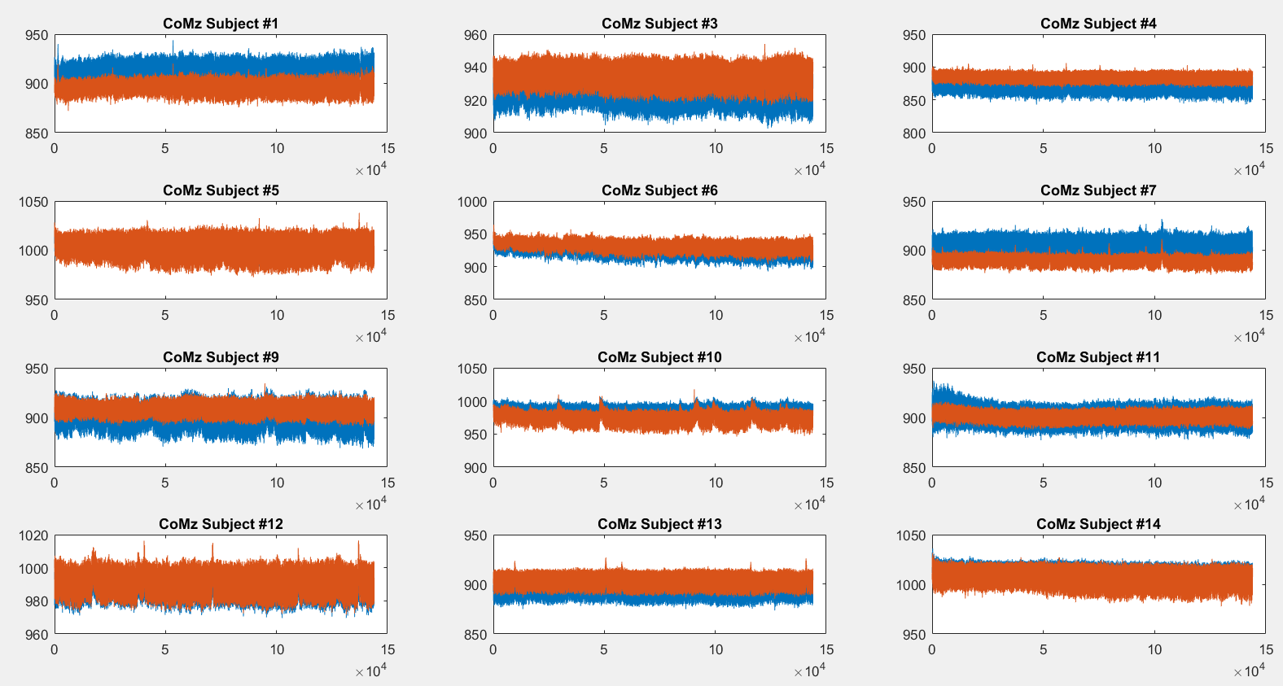

Slide 5
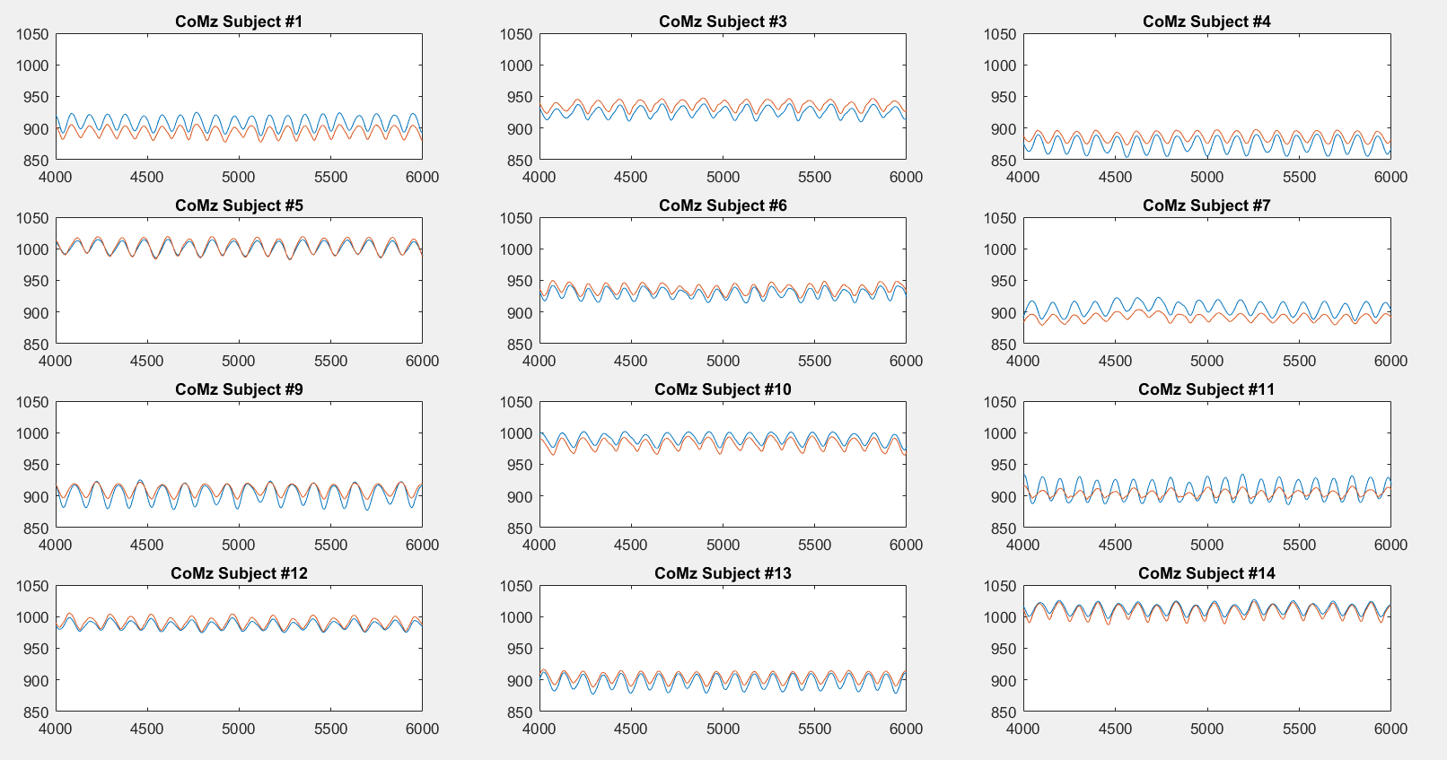

Slide 6
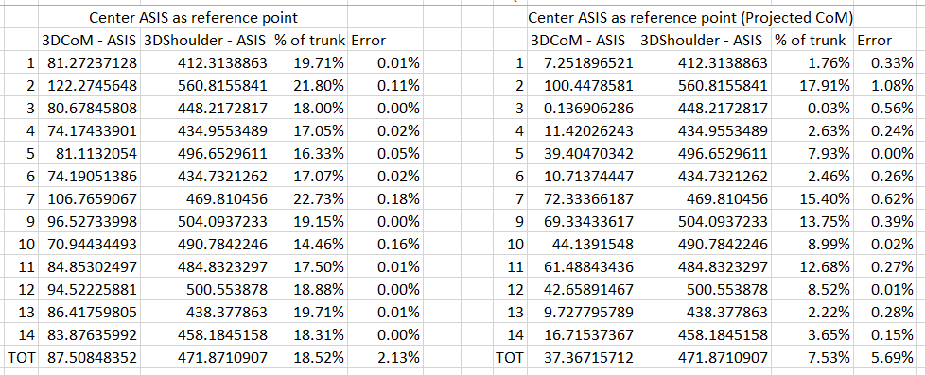
3D CoM

Slide 7
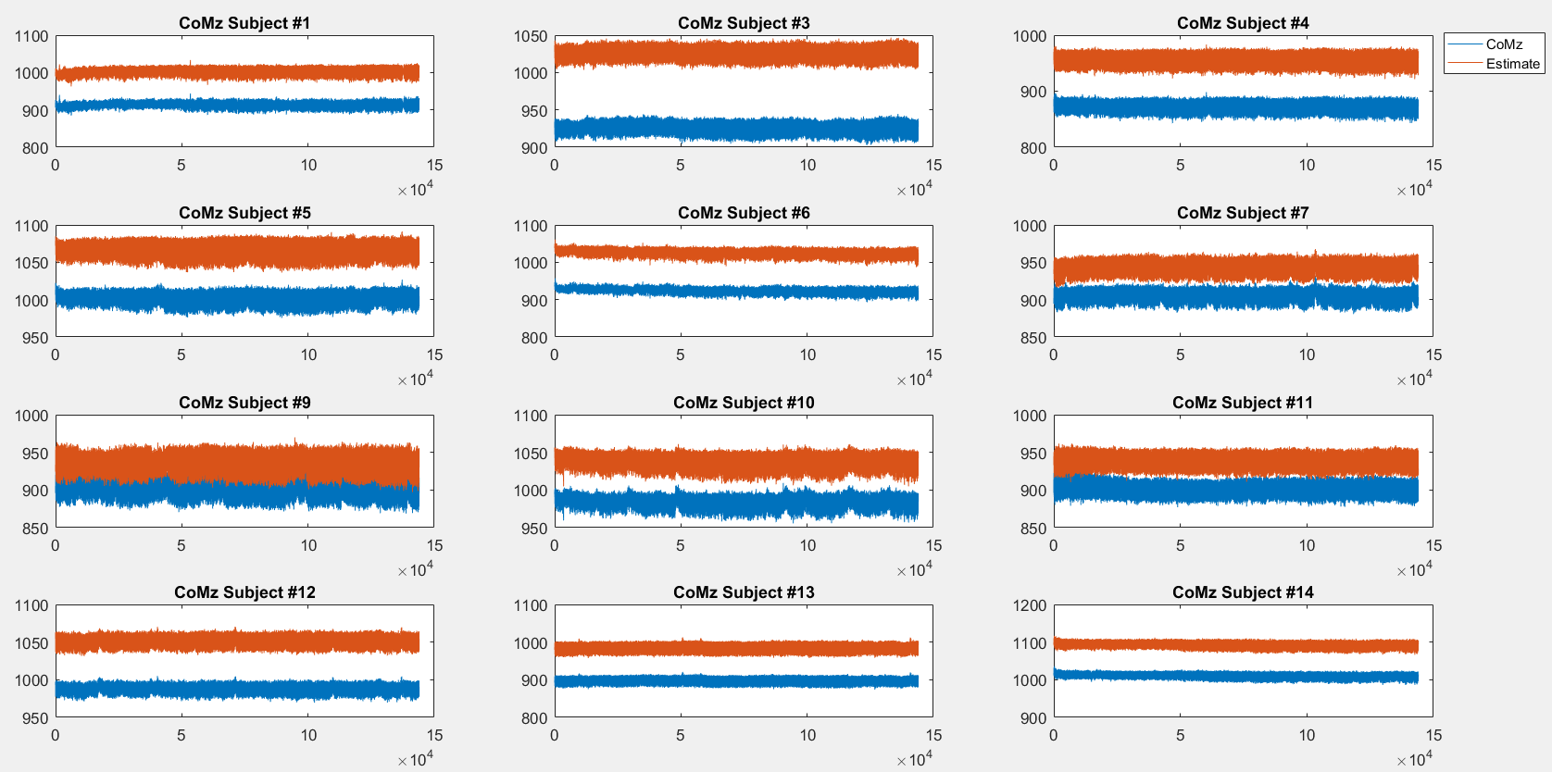
18% above asis point

Slide 8
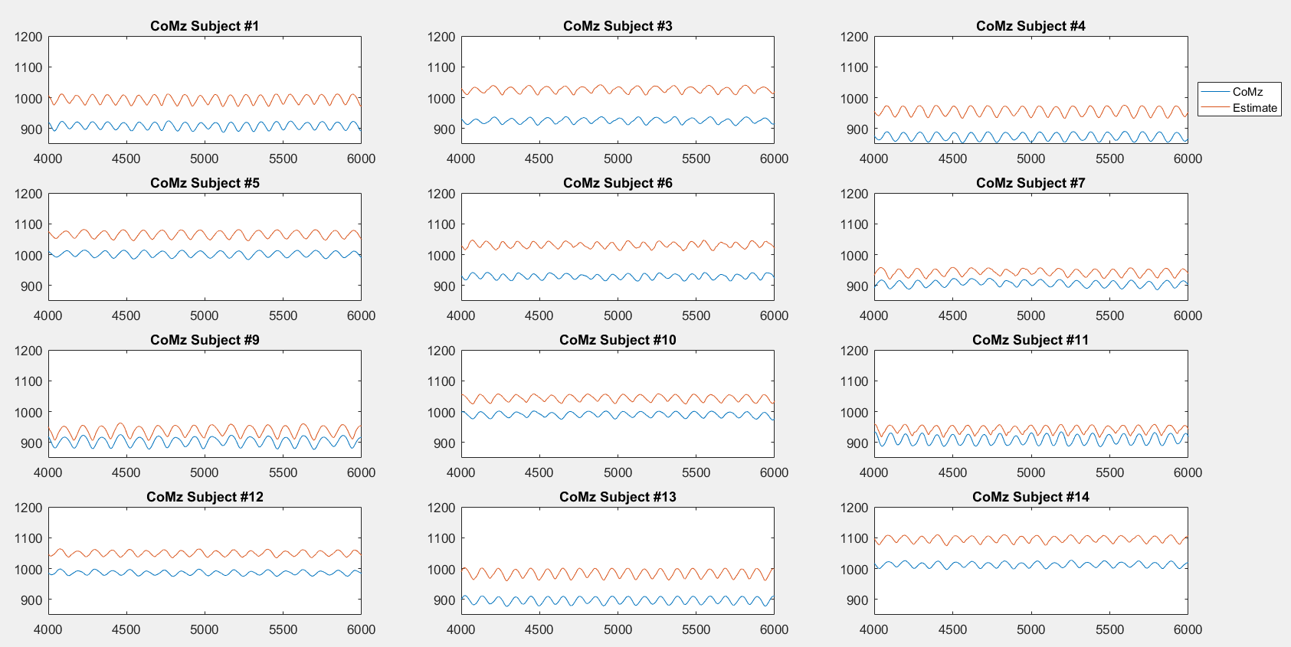
18% above asis point

Slide 9
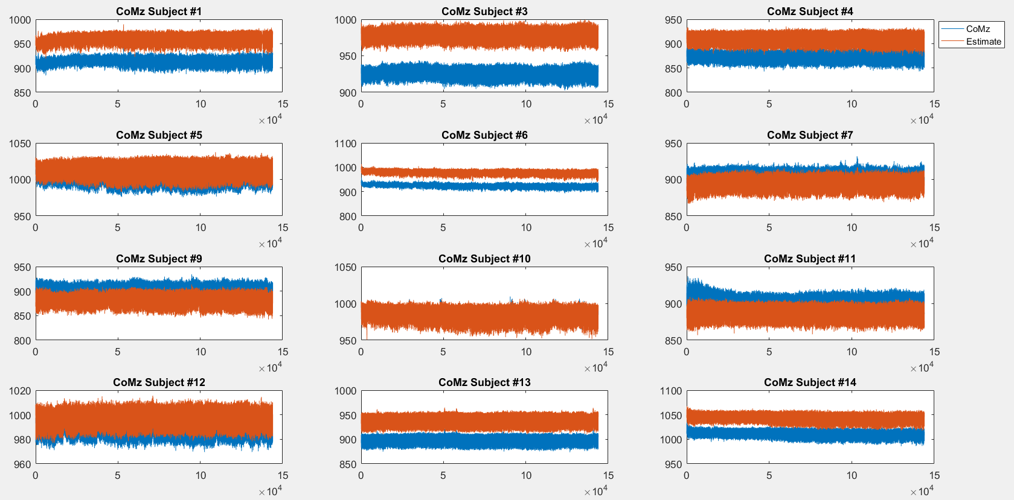
7.5% above asis point

Slide 10
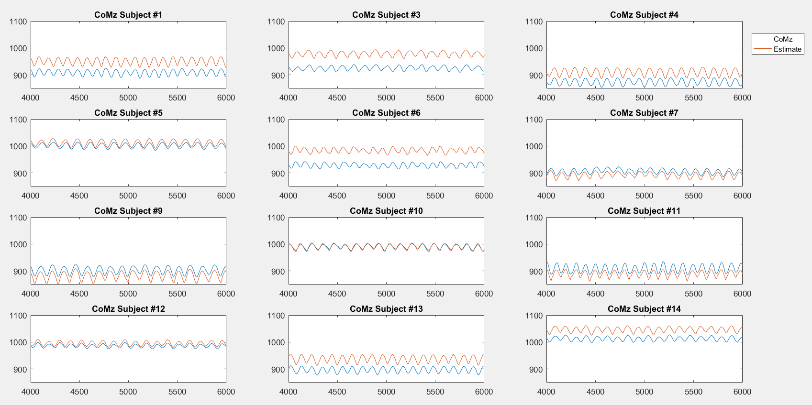
7.5% above asis point

Slide 11
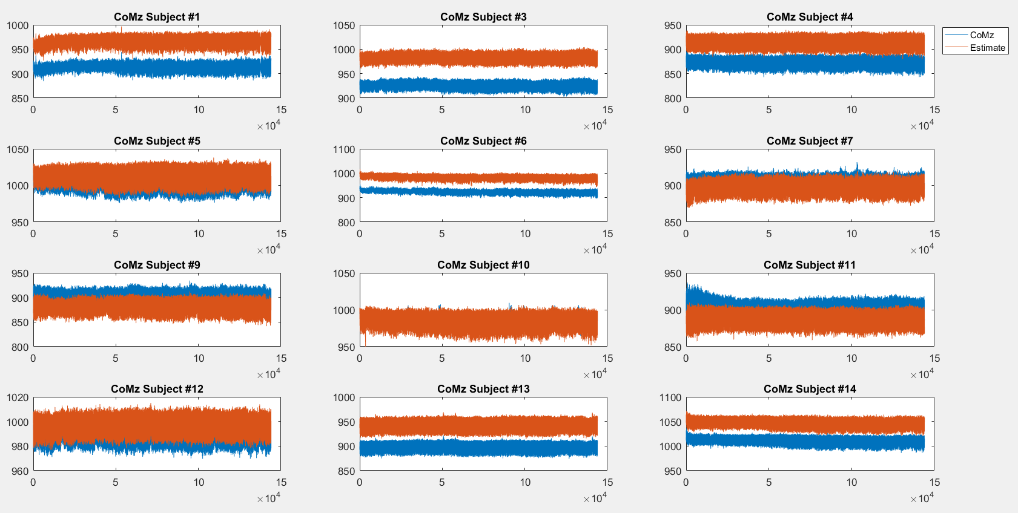
37 mm above asis point

Slide 12
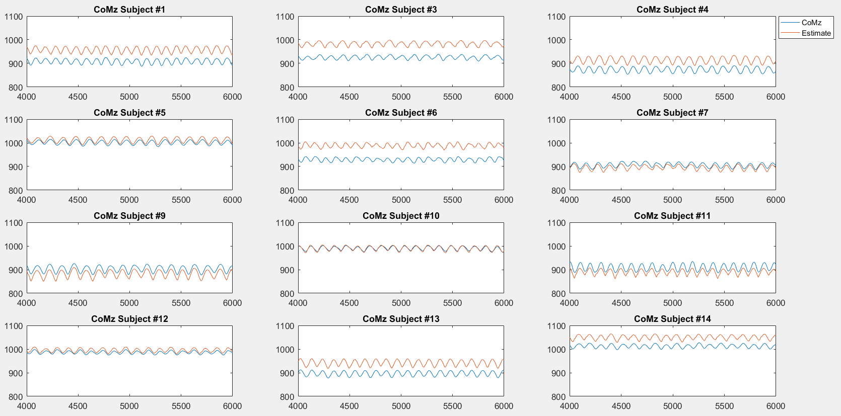
37 mm above asis point

